Slide 1
FACE RECOGNITION AND SENTIMENTAL ANALYSIS
By Real Time Solution Providers
1. Dr. Shweta Gupta ( Team Leader )
2. Taneeru Karthikeya (Team Member)
3. Varsshini R (Team Member)

Slide 2
Problem Statement?
This problem statement comes from real life incident when my debit card was lost and inspite of informing Bank Manager of ICICI Bank , Kumarswamy Layout , Stage -2 Branch , someone after two days withdrew Rs. 40000 from the ATM.
Besides that, it is used to provide safety and security for ATM transactions in rural areas as well as urban areas and hence , safe money transactions at ATM.
Solution provided concentrates on tampering with camera, time taken for activity on
premises and monitoring sentiments of customers for employee appraisal.

Slide 3
Model Description
Our products enable safe ATM transactions with face recognition, sentiment analysis for correct customer satisfaction feedback and subsequent alerts with back compatibility with latest technology incorporated and and providing services in various languages . The bank segment will be the early adopter of our product.
The bank will also use our product for better understanding of their clients as well as their feedbacks and would help in employee appraisal.

Slide 4
Model Description
Our idea to solve this problem is coming out with a ATM machine with a
camera embedded in it.
This camera which is embedded in it will have all the photos of all the ATM card holder’s.
When a person goes to withdraw money from ATM, the camera will help us check whether ATM card which is inserted , is that of card holder’s or not .

Slide 5
Special Features of our Solution
The software which is designed by us also recognizes facial expressions which makes the above process very quick in helping the customers who are in emergency.
Also the software understands the facial expressions and gives the bank the correct feedback about their experience.

Slide 6
Special Features of our Solution
Recognizing more than one person in the ATM camera, the pin will be disabled saying someone is peeping your pin.
If the person is seeing outside while inside the ATM, then we would also install one camera outside the ATM and take the video analytics of it also, so that if there is anything fishy it can be captured and analyzed and immediate alert can be sent to the bank for immediate action.

Slide 7
Special other features
Sentiments of customers
Tampering with the cameras / sensitive or high priority area within premises.
Count of People
Any activity that needs attention
Time taken for activity on premises
Identification of known facilitators
Feedback mechanism for false positives / incorrect classification for enhancement in model

Slide 8
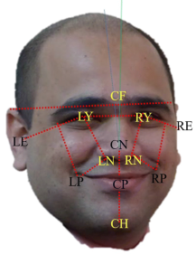
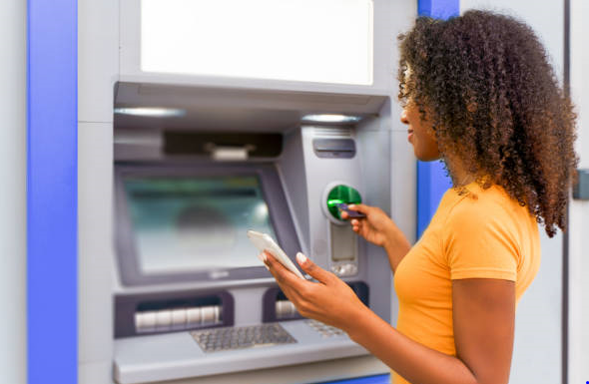
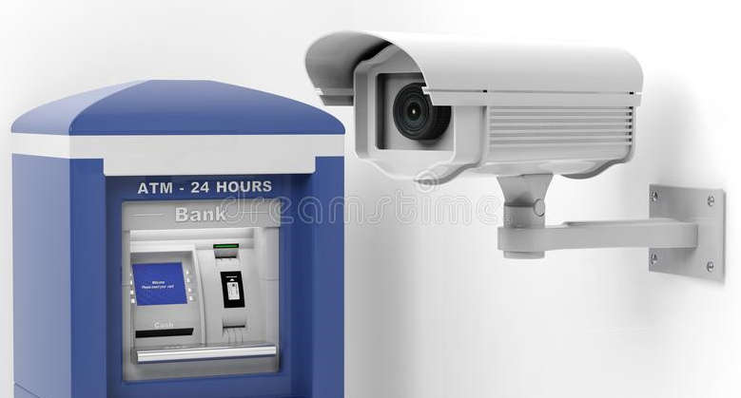
Solution Diagram
(ii) Camera monitoring everything
(i) Person going to ATM to draw money
(iii) Understanding Facial Expressions

Slide 9
Software Tools Used
Azure tools or resources which we have used :
1. Face Recognition and Sentiment Analysis by Video Indexer Service of Azure AI 2. Vision API and Face API Service of Azure API 3. Emotion API Service of Azure AI
4. Database service of Azure AI

Slide 10
Demo Video Showing the Functionalities of the Application
https://github.com/Varsshini321/face-recognition-and-sentimental-analysis

Slide 11
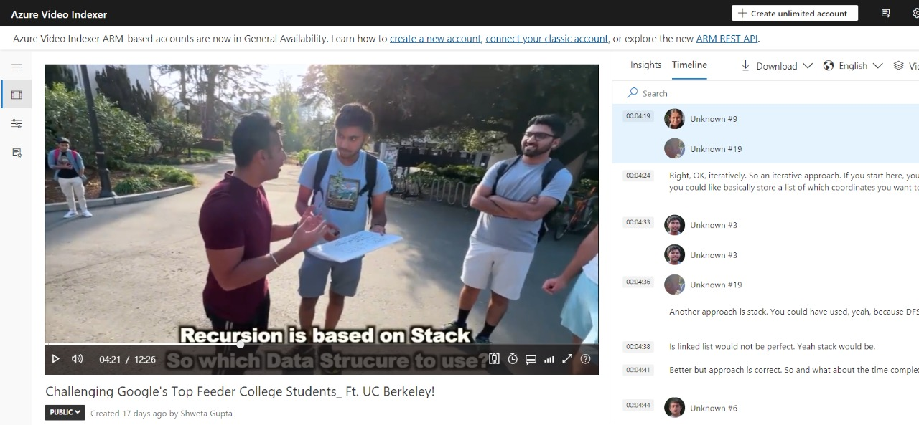
Results After Implementation
(i) Face and Transcript Recognition

Slide 12
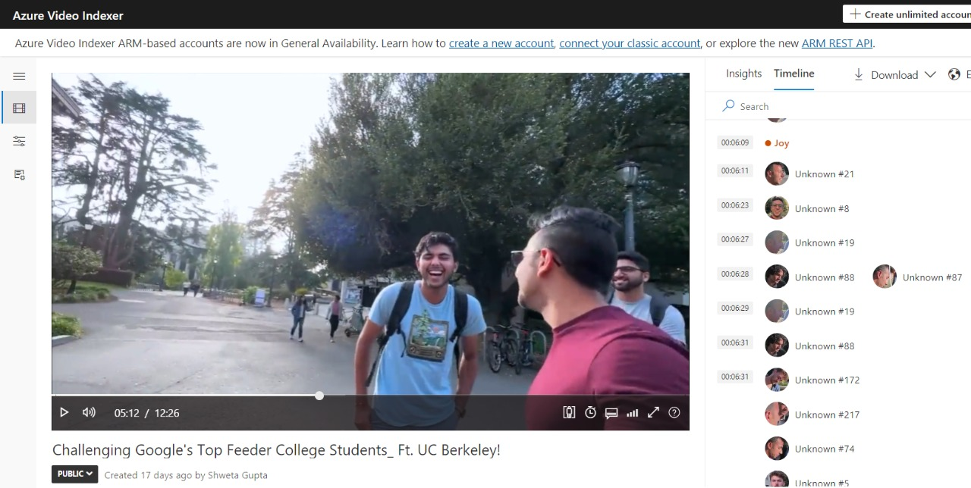
Results After Implementation
(ii) Face Recognition

Slide 13
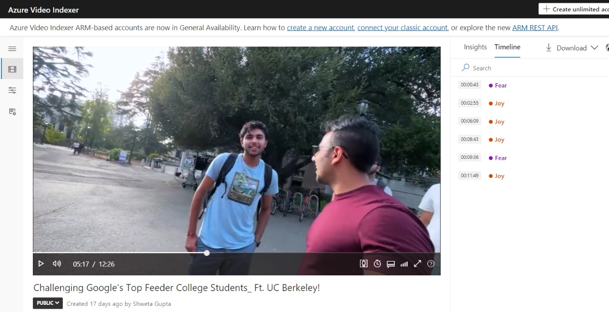
Results After Implementation
(iii) Sentimental Analysis

Slide 14
Test Case 1 – Sentiment Analysis at Different time

Slide 15
Test Case -2 Correct Face Identification at different time

Slide 16
Test Case -3 Correct Face and Transcript Description at Different Times
(i) Face and Transcript Recognition

Slide 17
Key Differentiators & Adoption Plan
Till now , there were only cameras in ATM machine centers which will capture who is entering into the ATM.
But all the cameras which exist till today will only capture the back of the person who will enter into ATM’s but our solution captures front face.
One more difference is that till today there is no camera which does this sort of job where you can prevent the theft before it occurs.
Considering all the above points ,we propose our idea as one of the solutions to avoid theft of money through ATM cards at ATM centers.

Slide 18
Ability to Scale –Up in Enterprise Grade Environment
Very Easily with appropriate Camera embedded inside ATM machine it can be upgraded to Real time environment with Video Indexer capabilities of face recognition , sentiment analysis and database service of Azure AI.

Slide 19
Plan for Deployment
Prerequisites from Bank Side :
1. Camera
2. Compatible ATM Machine
3. Azure AI – Video Indexer results monitoring person
Tentative Duration for Deployment : 6 months

Slide 20
PoC Key Performance Indicators (KPI’s)
Accuracy in Face Recognition
Exact Sentiment Analysis
Time Spent is less and quickly it gives results
Effective solution

Slide 21
Thank You

